Slide 1
Chemical Reactions and Equations
CHAPTER 14
Part 3- OXIDATION AND REDUCTION
Notes:
Lets start with our Chapter 1- that is Chemical Reactions and Equations

Slide 2
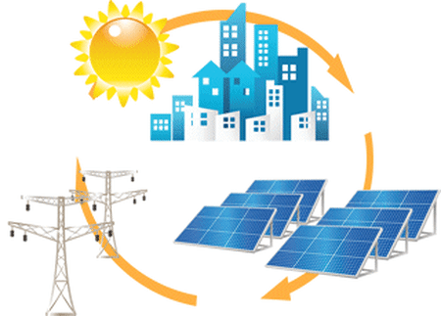
Non – conventional Sources of Energy
SOLAR ENERGY
The energy produced or radiated by the sun.
Energy derived from the sun's radiation. Solar energy is used on Earth in various ways.
As the name suggest.. It is the energy obtained from the sun’s radiations.
We use the pv cells to capture the radiations, store them and use it as electricity. We make use of a semiconductor present in the pv cells
Notes:
A photovoltaic cell, commonly called a solar cell or PV, is a technology used to convert solar energy directly into electricity. A photovoltaic cell is usually made from silicon alloys.
Particles of solar energy, known as photons, strike the surface of a photovoltaic cell between two semiconductors.
These semiconductors exhibit a property known as the photoelectric effect, which causes them to absorb the photons and release electrons. The electrons are captured in the form of an electric current - in other words, electricity.

Slide 3
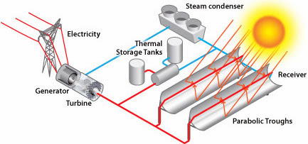
PHOTOVOLTAIC CELLS
Notes:
Photovoltaics are best known as a method for generating electric power by using solar cells to convert energy from the sun into a flow of electrons by the photovoltaic effect. Solar cells produce direct current electricity from sunlight which can be used to power equipment or to recharge a battery.

Slide 4

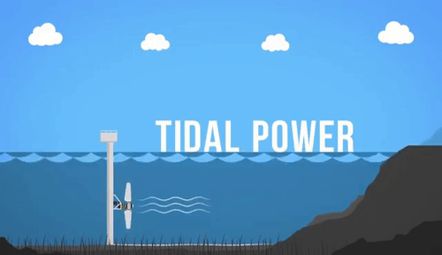
Tidal Energy
Tidal energy is the result of the moon and sun’s gravitational influence on the ocean.
Notes:
Tidal energy or tidal power can be defined as the energy that is the result of the moon and the sun’s gravitational influence on the ocean. Height differences between high and low tides create tidal currents in coastal areas, and these currents can be strong enough to drive turbines.

Slide 5
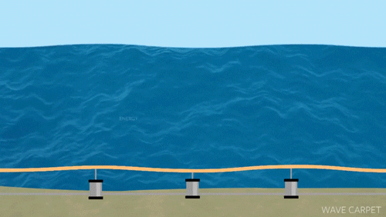
Wave Energy
Wave energy is produced due to the rise and fall of waves in the ocean
Notes:
Wave power is produced by the up and down motion of floating devices placed on the surface of the ocean. In other words, wind produces waves, and then waves produce energy. As the waves travel across the ocean, high-tech devices capture the natural movements of ocean currents and the flow of swells to generate power.

Slide 6
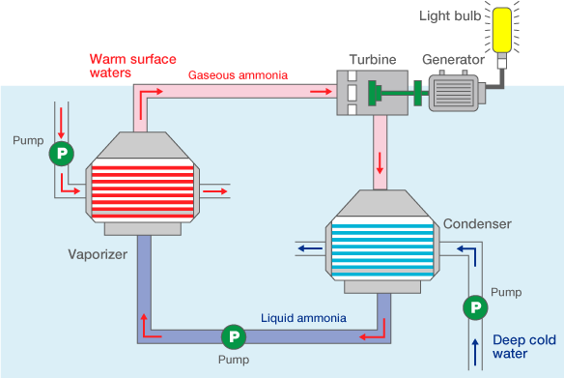
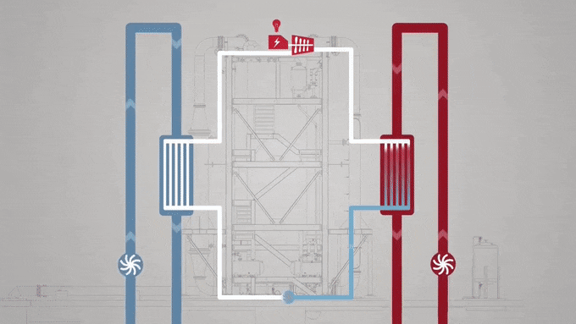
Ocean Thermal Energy
Ocean Thermal Energy Conversion (OTEC) is a process that can produce electricity by using the temperature difference between deep cold ocean water and warm tropical surface waters.
Notes:
Ocean Thermal Energy Conversion (OTEC) is a marine renewable energy technology that harnesses the solar energy absorbed by the oceans to generate electric power. ... OTEC uses the ocean's warm surface water with a temperature of around 25°C (77°F) to vaporize a working fluid, which has a low-boiling point, such as ammonia.

Slide 7
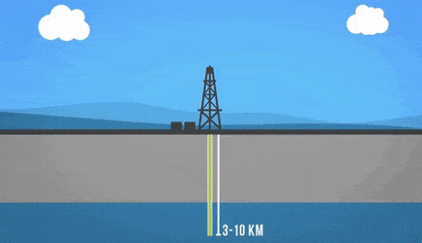
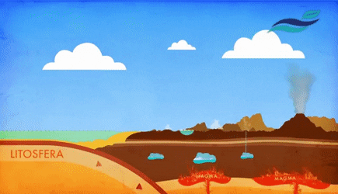
Geothermal Energy
Geothermal power plants are used in order to generate electricity by the use of geothermal energy
Hot water or steam is extracted from the Earth through a series of wells and feeds the power plant.
Notes:
Geothermal power plants are used in order to generate electricity by the use of geothermal energy (the Earth's internal thermal energy). They essentially work the same as a coal or nuclear power plant, the main difference being the heat source. With geothermal, the Earth's heat replaces the boiler of a coal plant or the reactor of a nuclear plant.^{[2]} Click here to learn how this heat is produced.
Hot water or steam is extracted from the Earth through a series of wells and feeds the power plant. In most geothermal plants the water pulled up from the ground is returned back to the subsurface. The rate of water used is often larger than the rate of water returned, so make-up water supplies are generally needed.
Geothermal power plants are used in order to generate electricity by the use of geothermal energy (the Earth's internal thermal energy). They essentially work the same as a coal or nuclear power plant, the main difference being the heat source. With geothermal, the Earth's heat replaces the boiler of a coal plant or the reactor of a nuclear plant.^{[2]} Click here to learn how this heat is produced.
Hot water or steam is extracted from the Earth through a series of wells and feeds the power plant. In most geothermal plants the water pulled up from the ground is returned back to the subsurface. The rate of water used is often larger than the rate of water returned, so make-up water supplies are generally needed.

Slide 8
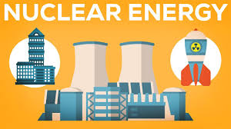
Nuclear Energy
The energy released during nuclear fission or fusion, especially when used to generate electricity.
The energy released during nuclear fission or fusion, especially when used to generate electricity.
Notes:
The energy released during nuclear fission or fusion, especially when used to generate electricity.
Nuclear energy originates from the splitting of uranium atoms – a process called fission. This generates heat to produce steam, which is used by a turbine generator to generate electricity. Because nuclear power plants do not burn fuel, they do not produce greenhouse gas emissions.

Slide 9
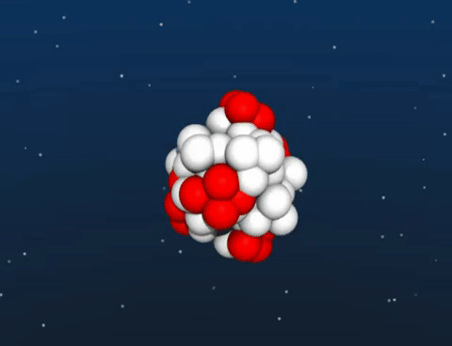
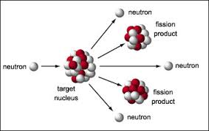
Nuclear Fission
Nuclear fission is a process in nuclear physics in which the nucleus of an atom splits into two or more smaller nuclei as fission products, and usually some by-product particles.
Notes:
In nuclear fission the nucleus of an atom breaks up into two lighter nuclei. The process may take place spontaneously in some cases or may be induced by the excitation of the nucleus with a variety of particles (e.g., neutrons, protons, deuterons, or alpha particles) or with electromagnetic radiation in the form of gamma rays.

Slide 10
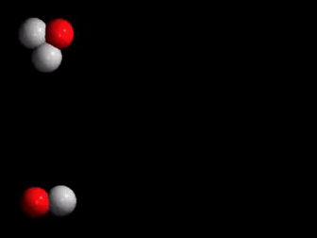
Nuclear Fusion
Nuclear fusion is the process of making a single heavy nucleus (part of an atom) from two lighter nuclei.
Notes:
It is a nuclear process, where energy is produced by smashing together light atoms. It is the opposite reaction of fission, where heavy isotopes are split apart. Fusion is the process by which the sun and other stars generate light and heat.
t’s most easily achieved on Earth by combining two isotopes of hydrogen: deuterium and tritium. Hydrogen is the lightest of all the elements, being made up of a single proton and a electron. Deuterium has an extra neutron in its nucleus; it can replace one of the hydrogen atoms in H₂0 to make what is called “heavy water.” Tritium has two extra neutrons, and is therefore three times as heavy as hydrogen. In a fusion cycle, tritium and deuterium are combined and result in the formation of helium, the next heaviest element in the Periodic Table, and the release of a free neutron.

Slide 11
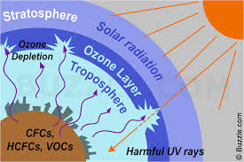
Ozone Depletion
When a nuclear weapon explodes in the air, the surrounding air is subjected to great heat, followed by relatively rapid cooling.
Notes:
When a nuclear weapon explodes in the air, the surrounding air is subjected to great heat, followed by relatively rapid cooling. These conditions are ideal for the production of tremendous amounts of nitric oxides. These oxides are carried into the upper atmosphere, where they reduce the concentration of protective ozone. Ozone is necessary to block harmful ultraviolet radiation from reaching the Earth's surface.

Slide 12
Ozone Depletion
NO
+
O₃
NO₂
+
O₂
NO₂
+
O
NO
+
O₂
Net O
+
O₃
2O₂
Notes:
The nitric oxides produced by the weapons could reduce the ozone levels in the Northern Hemisphere by as much as 30 to 70 percent. Such a depletion might produce changes in the Earth's climate, and would allow more ultraviolet radiation from the sun through the atmosphere to the surface of the Earth, where it could produce dangerous burns and a variety of potentially dangerous ecological effects.
It has been estimated that as much as 5,000 tons of nitric oxide is produced for each megaton of nuclear explosive power.

